Slide 1

Airbnb real estate investment analysis
Judah Easton

Slide 2


Inspiration
Investing in a property for extra income has been something I've been considering for retirement.
I wanted to get an idea of what metrics are involved in making a data driven decision for a short-term rental investment.

Slide 3

introduction
Find top states that match the most kpi’s
metrics to determine best strategies when considering a short-term rental property investment.
average lengths of stays, NOI comparisons and average bookings to determine the states best for short -term rental.
Occupancy rate, daily rates, property tax and average annual revenue considerations.

Slide 4

Kpi topics
Airbnb statistics
Key short term rental statistics by state and city
Str and ltr noi comparisons
Occupancy rate analysis
Property tax, home price, revenue analysis
State attraction analysis
Property value trends up to 2022

Slide 5


Why use airbnb?
Airbnb is estimated to have over 150 million users, with over 45 million users in the U.S.
There are over 100,000 cities and towns with active Airbnb listings.
394 million ‘nights and experiences’ were booked on Airbnb around the world in 2022.
Every second, 5 to 10 guests check into an Air bnb somewhere in the world.

Slide 6

Why use airbnb?
On average, people stay in an Airbnb booking for 4 nights.
The average host earned $14,000 in 2022.
Over 60% of U.S. hosts say they rent out their primary home while they’re on vacation.
Over 4 million hosts have 7 million global listings on Airbnb.
Airbnb has had over 1.5 billion guest arrivals since it started in 2007.
Notes:
Why use air bnb

Slide 7

Why invest in str over ltr?
Growing demand in US STR industry
$64 billion annual revenue, the highest yet
24 million nights stayed in July, the most in-demand month on record
Opportunity to use the rental at your discretion
Sum of Net operating incomes :
Vacation rental noi
$244,014
Long term rental noi
$224,516

Slide 8

Short term vs long term rental

Slide 9

Attractions
State Attractions can help give a starting point or solidify a potential investment area
Smaller state attractions should also be considered while comparing occupancy rates
Number of Major Attractions
CA | MA | FL | TN | NV | WA | MI | IL
6 | 1 | 4 | 1 | 1 | 1 | 1 | 3

Slide 10
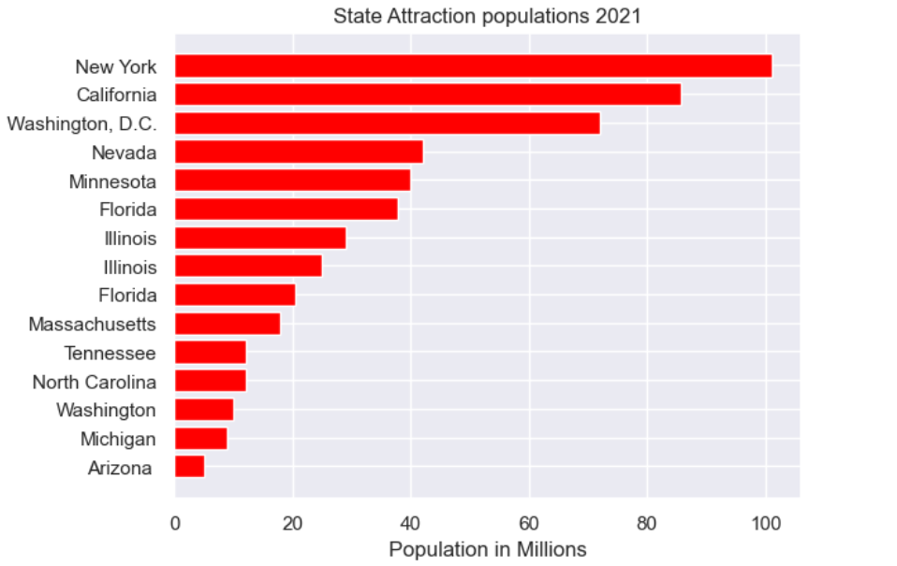
State Attraction visitors

Slide 11
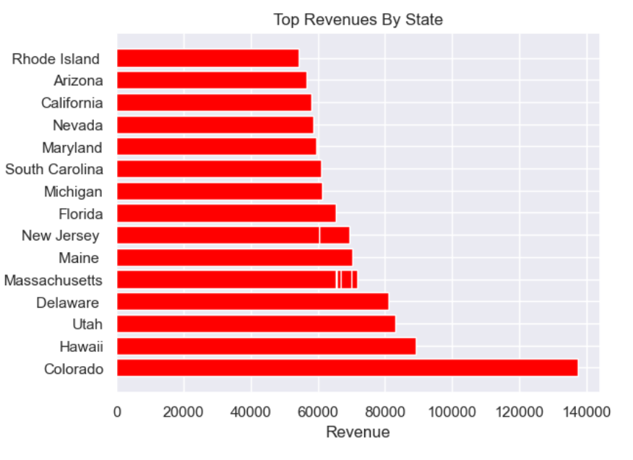

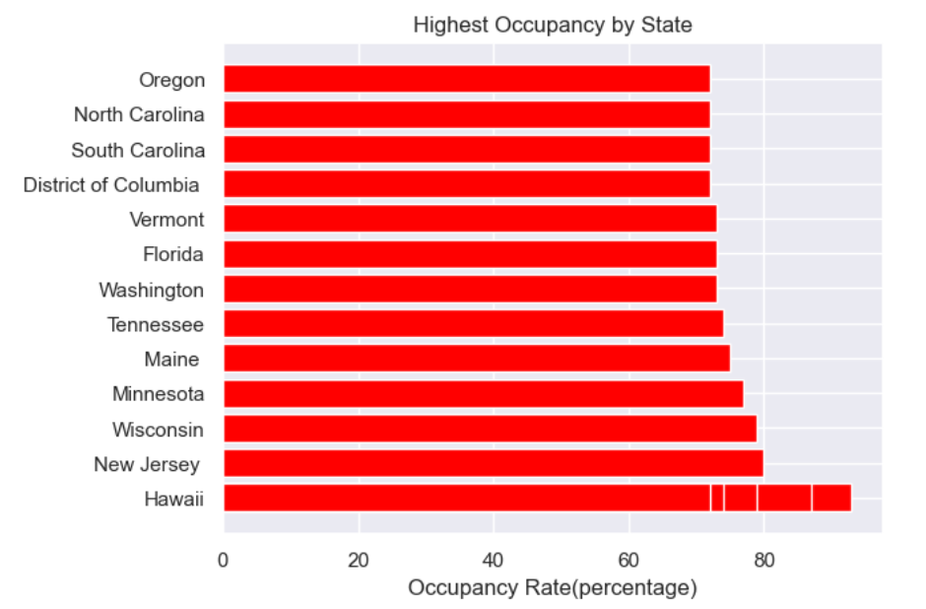
Occupancy and revenue metrics

Slide 12
Annual revenue & Occupancy Data

Slide 13
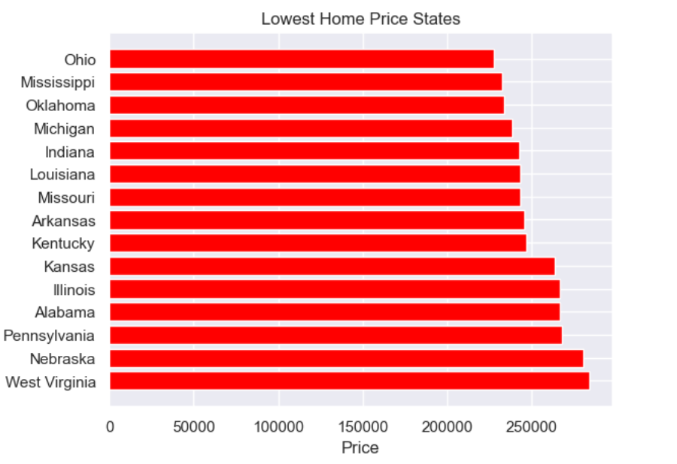
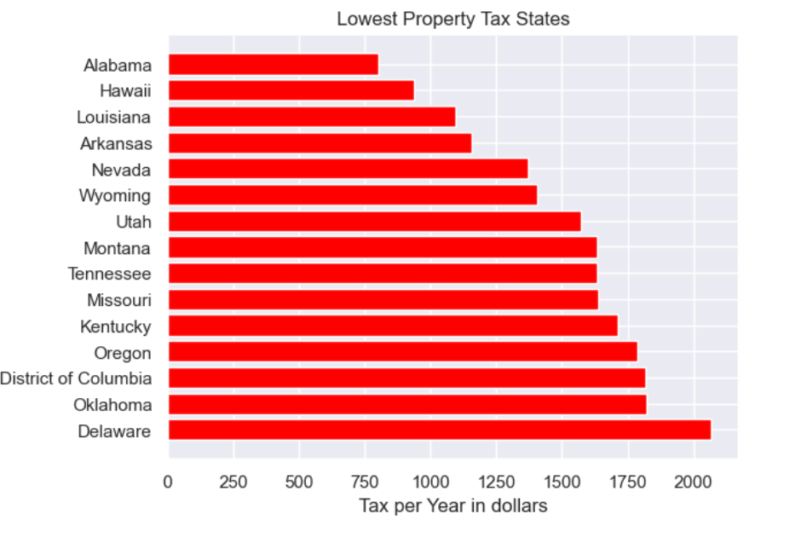
Property tax - home price
Property tax and home price comparisons give insight into where you would want to purchase the property

Slide 14
Avg State Tax

Slide 15

Housing price trends
An indicator of how the property value in a state has gone up or down over a set amount of time to determine long-term investment potential.
1-Year , 5-Year, and 10+ year trend data is what we’ll be exploring

Slide 17
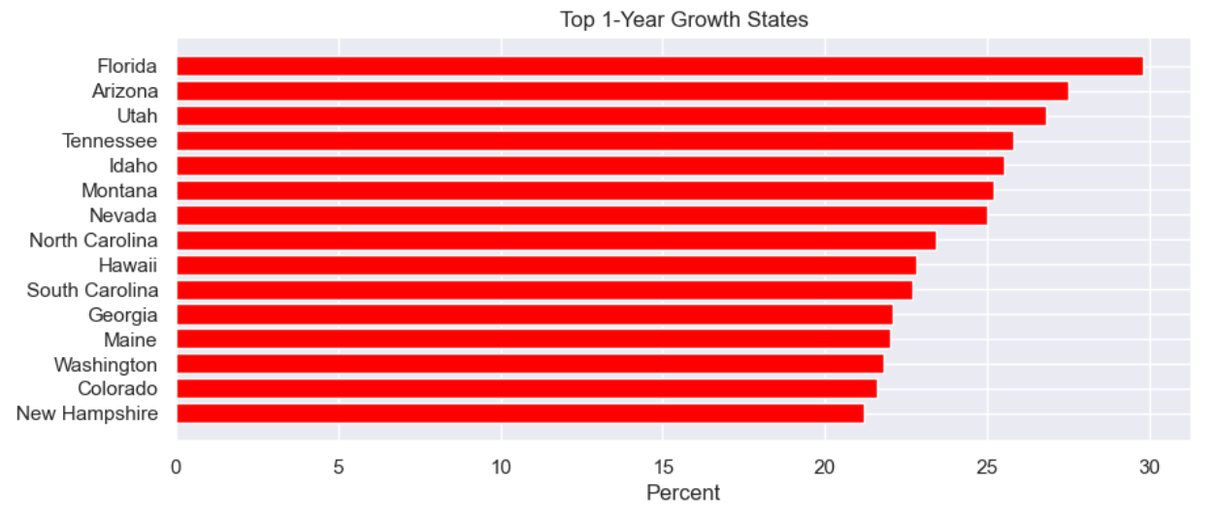
1-year housing price growth
Year 2021 - 2022

Slide 18

Summary
Top states by KPI :
Occupancy
Property tax
Home price
Attractions
Annual revenue
Property value trends over time

Slide 19
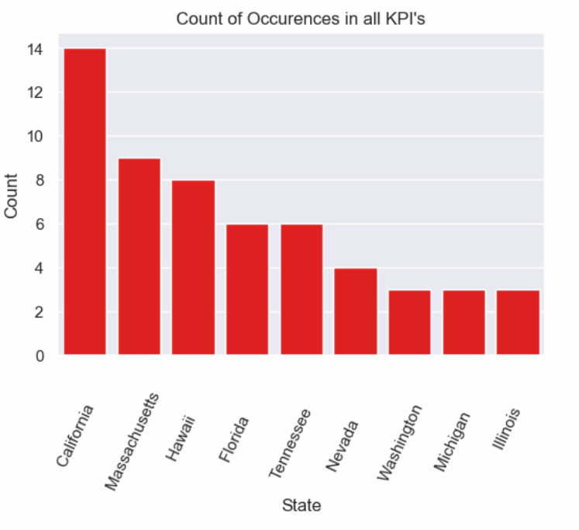
conclusions
Top states that meet kpi conditions
Count of each time the state occurred in the kpi categories
Some states occurred more times due to their many attractions
Number of listings can also be considered for oversaturation of an area market available via occupancy dashboard

Slide 20

Thank you for your time

Slide 21
sources
Housing Data - Zillow Research
Redfin | Real Estate & Homes for Sale, Rentals, Mortgages & Agents
15 Best U.S. Cities for Investing in Airbnb | Extra Space Storage
Airbnb vs. Long-Term Rentals: Which Makes the Most Profit? An Analysis of the 50 Largest U.S. Markets - Real Estate Data & Research (renthop.com)
Airbnb Data: Occupancy Rates by Zipcode | Airbtics | Airbnb Analytics
Mapped: The Growth in U.S. House Prices by State (visualcapitalist.com)
Tourist attractions in the United States – Wikipedia
Airbnb Statistics by City in the US 2024 | Hospitable
Property Taxes By State: Highest To Lowest | Rocket Mortgage

